Slide 1
Securities Markets
3
Bodie, Kane, and Marcus
Essentials of Investments, 9th Edition

Slide 2
3.1 How Firms Issue Securities
Primary vs. Secondary Market Security Sales
  Primary
    New issue created/sold
    Key factor: Issuer receives proceeds from sale
    Public offerings: Registered with SEC; sale made to investing public
    Private offerings: Not registered; sold only to limited number of investors with restrictions on resale
  Secondary
    Existing owner sells to another party
    Issuing firm doesn’t receive proceeds, is not directly involved

Slide 3
3.1 How Firms Issue Securities
Privately Held Firms
  Up to 499 shareholders
  Fewer obligations to release financial statements to public
  Private placement: Primary offerings sold directly to a small group of investors

Slide 4
3.1 How Firms Issue Securities
Publicly Traded Companies
  Sell securities to the general public; allow investors to trade shares in securities markets
  Initial public offering: First sale of stock by a formerly private company
  Underwriters: Purchase securities from issuing company and resell them
  Prospectus: Description of firm and security being issued

Slide 5
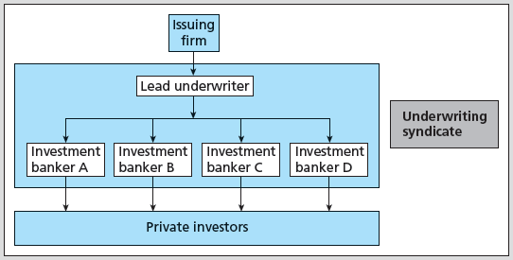
Figure 3.1 Relationship among a Firm Issuing Securities, the Underwriters, and the Public

Slide 6
3.1 How Firms Issue Securities
Shelf Registration
  SEC Rule 415
    Security is preregistered and then may be offered at any time within the next two years
      24-hour notice: Any or all of preregistered amount may be offered
  Introduced in 1982
  Allows timing of issues

Slide 7
3.1 How Firms Issue Securities
Initial Public Offerings
  Issuer and banker put on “road show”
  Purpose: Bookbuilding and pricing
  Underpricing
    Post-initial sale returns average 10% or more—“winner’s curse” problem?
    Easier to market issue; costly to issuing firm
Notes:
7

Slide 8
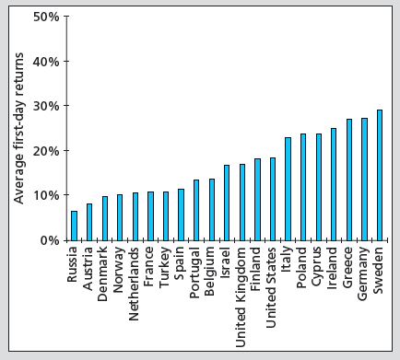
Figure 3.2 Average First-Day Returns for European IPOs

Slide 9
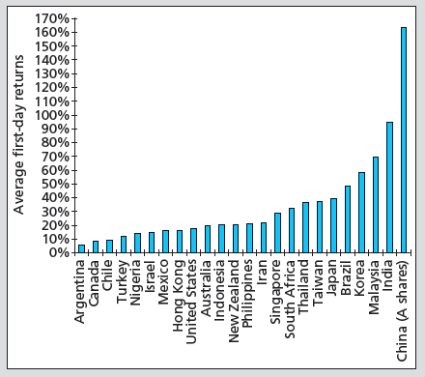
Figure 3.2 Average First-Day Returns for Non-European IPOs

Slide 10
3.2 How Securities Are Traded
Functions of Financial Markets
  Overall purpose: Facilitate low-cost investment
    Bring together buyers and sellers at low cost
    Provide adequate liquidity by minimizing time and cost to trade and promoting price continuity
    Set and update prices of financial assets
  Reduce information costs associated with investing
Notes:
10

Slide 11
3.2 How Securities Are Traded
Types of Markets
  Direct Search Markets
    Buyers and sellers locate one another on their own
  Brokered Markets
    Third-party assistance in locating buyer or seller
  Dealer Markets
    Third party acts as intermediate buyer/seller
  Auction Markets
    Brokers and dealers trade in one location
    Trading is more or less continuous

Slide 12
3.2 How Securities Are Traded
Types of Orders
  Market order: Execute immediately at best price
    Bid price: price at which dealer will buy security
    Ask price: price at which dealer will sell security
  Price-contingent order: Buy/sell at specified price or better
    Limit buy/sell order: specifies price at which investor will buy/sell
    Stop order: not to be executed until price point hit

Slide 13
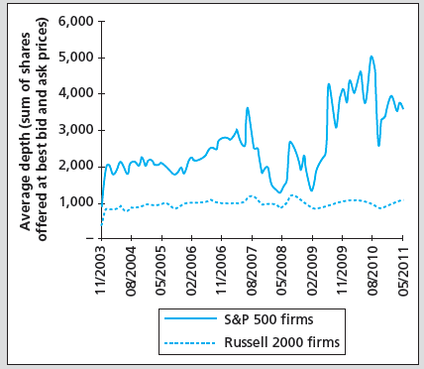
Figure 3.3 Average Market Depth for Large (S&P 500) and Small (Russel 2000) Firms

Slide 14
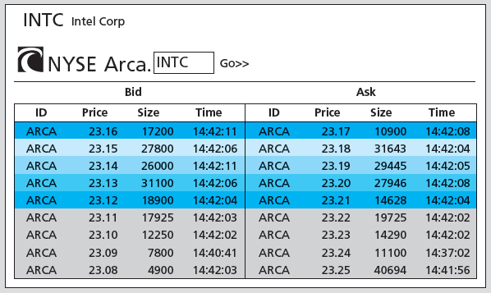
Figure 3.4 Limit Order Book for Intel on the NYSE Arca Market, July 22, 2011

Slide 15
3.2 How Securities Are Traded
Trading Mechanisms
  Dealer markets
    Over-the-counter (OTC) market: Informal network of brokers/dealers who negotiate securities sales
    NASDAQ stock market: Computer-linked price quotation system for OTC market
  Electronic communication networks (ECNs)
    Computer networks that allow direct trading without market makers
  Specialist markets
    Specialist: Makes market in shares of one or more firms; maintains “fair and orderly market” by dealing personally

Slide 16
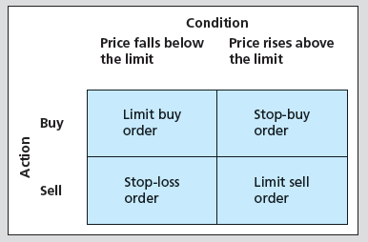
Figure 3.5 Price-Contingent Orders

Slide 17
3.3 The Rise of Electronic Trading
Timeline of Market Changes
  1969: Instinet (first ECN) established
  1975: Fixed commissions on NYSE eliminated
    Congress amends Securities and Exchange Act to create National Market System (NMS)
  1994: NASDAQ scandal
    SEC institutes new order-handling rules
    NASDAQ integrates ECN quotes into display
    SEC adopts Regulation Alternative Trading Systems, giving ECNs ability to register as stock exchanges

Slide 18
3.3 The Rise of Electronic Trading
Timeline of Market Changes
  1997: SEC drops minimum tick size from 1/8 to 1/16 of $1
  2000: National Association of Securities Dealers splits from NASDAQ
  2001: Minimum tick size $.01
  2006: NYSE acquires Archipelago Exchanges and renames it NYSE Arca
    SEC adopts Regulation NMS, requiring exchanges to honor quotes of other exchanges

Slide 19
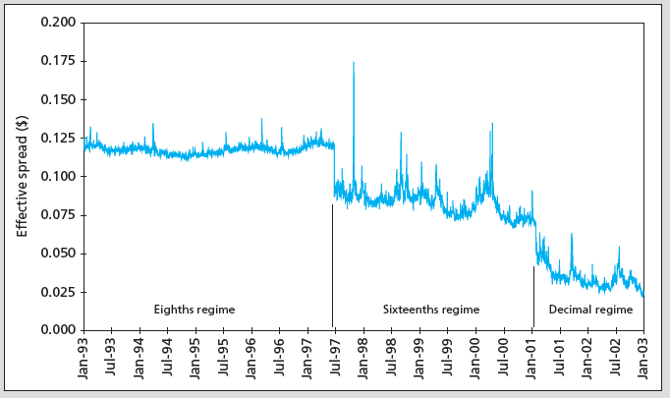
Figure 3.6 Effective Spread vs. Minimum Tick Size

Slide 20
3.4 U.S. Markets
NASDAQ
  Approximately 3,000 firms
New York Stock Exchange (NYSE)
  Stock exchanges: Secondary markets where already-issued securities are bought and sold
  NYSE is largest U.S. Stock exchange
ECNs
  Latency: Time it takes to accept, process, and deliver a trading order

Slide 21
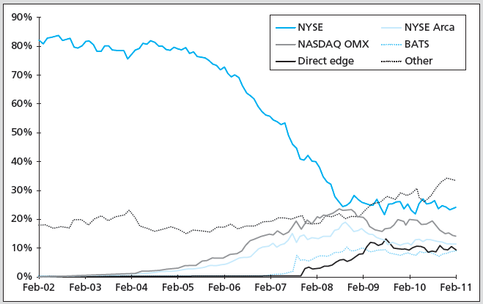
Figure 3.7 Market Share of Trading in NYSE-Listed Shares

Slide 22
3.5 New Trading Strategies
Algorithmic Trading
  Use of computer programs to make rapid trading decisions
  High-frequency trading: Uses computer programs to make very rapid trading decisions in order to compete for very small profits
Dark Pools
  ECNs where participants can buy/sell large blocks of securities anonymously
  Blocks: Transactions of at least 10,000 shares

Slide 23
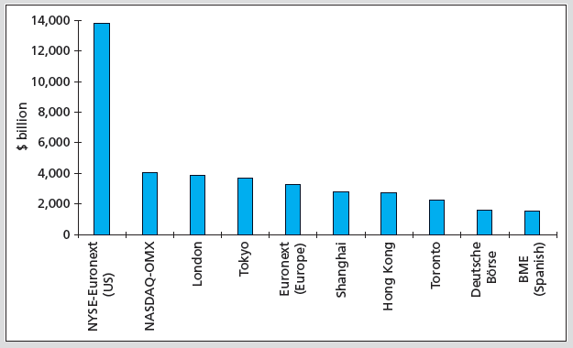
Figure 3.8 Market Capitalization of Major World Stock Exchanges, 2011

Slide 24
3.6 Globalization of Stock Markets
Moving to automated electronic trading
Current trends will eventually result in 24-hour global markets
Moving toward market consolidation

Slide 25
3.7 Trading Costs
Commission: Fee paid to broker for making transaction
Spread: Cost of trading with dealer
  Bid: Price at which dealer will buy from you
  Ask: Price at which dealer will sell to you
  Spread: Ask — bid
Combination: On some trades both are paid

Slide 26
3.8 Buying on Margin
Margin: Describes securities purchased with money borrowed in part from broker
  Net worth of investor's account
Initial Margin Requirement (IMR)
  Minimum set by Federal Reserve under Regulation T, currently 50% for stocks
  Minimum % initial investor equity
  1 − IMR = Maximum % amount investor can borrow

Slide 27
3.8 Buying on Margin
Equity
  Position value – Borrowing + Additional cash
Maintenance Margin Requirement (MMR)
  Minimum amount equity can be before additional funds must be put into account
  Exchanges mandate minimum 25%
Margin Call
  Notification from broker that you must put up additional funds or have position liquidated

Slide 28
3.8 Buying on Margin
If Equity / Market value ≤ MMR, then margin call occurs
(Market value – Borrowed) / Market Value ≤ MMR; solve for market value
A margin call will occur when:
  Market value = Borrowed/(1 − MMR)

Slide 29
3.8 Buying on Margin
Margin Trading: Initial Conditions
  X Corp: Stock price = $70
  50%: Initial margin
  40%: Maintenance margin
  1000 shares purchased
Initial Position
Stock | $70,000 | Borrowed | $35,000
 |  | Equity | $35,000

Slide 30
3.8 Buying on Margin
Stock price falls to $60 per share
  Position value – Borrowing + Additional cash
Margin %: $25,000/$60,000 = 41.67%
How far can price fall before margin call?
  Market value = $35,000/(1 – .40) = $58,333
New Position
Stock | $60,000 | Borrowed | $35,000
 |  | Equity | $25,000

Slide 31
3.8 Buying on Margin
With 1,000 shares, stock price for margin call is $58,333/1,000 = $58.33
Margin % = $23,333/$58,333 = 40%
  To restore IMR, equity = ½ x $58,333 = $29,167
New Position
Stock | $60,000 | Borrowed | $35,000
 |  | Equity | $23,333

Slide 32
3.8 Buying on Margin
Buy at $70 per share
  Borrow at 7% APR interest cost if using margin; use full amount margin
  APRs (365-day year)
Buy at $70 | Sell at $72 in 90 days | Sell at $68 in 90 days
No margin | 11.59% | −11.59%
Margin | 16.17% | −30.17%
Leverage factor | 1.4x | 2.6x

Slide 33
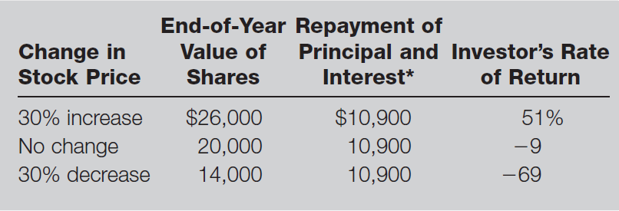
Table 3.1 Illustration of Buying Stock on Margin

Slide 34
3.9 Short Sales
Sale of shares not owned by investor but borrowed through broker and later purchased to replace loan
Mechanics
  Borrow stock from broker; must post margin
  Broker sells stock, and deposits proceeds/margin in margin account (you cannot withdraw proceeds until you “cover”)
  Covering or closing out position: Buy stock; broker returns title to party from which it was borrowed

Slide 35
3.9 Short Sales
Round Trips
  Long position
    Buy first, sell later
    Bullish
  Short position
    Sell first, buy later
    Bearish
  “Round trip” is a purchase and a sale

Slide 36
3.9 Short Sales
Required initial margin: Usually 50%
  More for low-priced stocks
Liable for any cash flows
  Dividend on stock
Zero tick, uptick rule
  Eliminated by SEC in July 2007

Slide 37
3.9 Short Sales
Short-sale maintenance margin requirements (equity)
Price | MMR
< $2.50 | $2.50
$2.50-$5.00 | 100% market value
$5.00-$16.75 | $5.00
> $16.75 | 30% market value

Slide 38
3.9 Short Sales
Example
  You sell 100 short shares of stock at $60 per share
    $6,000 must be pledged to broker
    You must also pledge 50% margin
    You put up $3,000; now you have $9,000 in margin account
  Short sale equity = Total margin account – Market value

Slide 39
3.9 Short Sales
Example
  Maintenance margin for short sale of stock with price > $16.75 is 30% market value
    30% x $6,000 = $1,800
  You have $1,200 excess margin
  What price for margin call?

Slide 40
3.9 Short Sales
Example
  When equity ≤ (.30 x Market value)
    Equity = Total margin account – Market value
  When Market value = Total margin account / (1 + MMR)
    Market value = $9,000/(1 + 0.30) = $6,923
  Price for margin call: $6,293/100 shares = $69.23

Slide 41
3.9 Short Sales
Example
  If this occurs:
    Equity = $9,000 − $6,923 = $2,077
    Equity as % market value = $2,077/$6,923 = 30%
  To restore 50% initial margin:
    ($6,923/2) − $2,077 = $1,384.50

Slide 42
Table 3.2 Cash Flows from Purchasing vs. Short-Selling
Purchase of Stock
Time | Action | Cash Flow*
0 | Buy share | − Initial price
1 | Receive dividend, sell share | Ending price + Dividend
Profit = (Ending price + Dividend) – Initial price
Short Sale of Stock
Time | Action | Cash Flow*
0 | Borrow share; sell it | + Initial price
1 | Repay dividend and buy share to replace share originally borrowed | − (Ending price + Dividend)
Profit = Initial price – (Ending price + Dividend)
*Note: A negative cash flow implies a cash outflow.

Slide 43
3.10 Regulation of Securities Markets
Self-Regulation
The Sarbanes-Oxley Act
Insider Trading
  Inside information: Nonpublic knowledge about a corporation possessed by officers, major owners, etc., with privileged access to information

