Slide 1
Mutual Funds and Other Investment Companies
4
Bodie, Kane, and Marcus
Essentials of Investments, 9th Edition

Slide 2
4.1 Investment Companies
Functions
  Record keeping and administration
  Diversification and divisibility
  Professional management
  Lower transaction costs
Definitions
  Investment company: Financial intermediaries
  Net asset value (NAV): Assets minus liabilities per share

Slide 3
4.2 Types of Investment Companies
Unit Investment Trusts
  Money pooled from many investors is invested in portfolio fixed for life of fund
Managed Investment Companies
  Open-end fund: Issues or redeems shares at net value
  Closed-end fund: Shares can’t be redeemed, are traded at prices different than NAV
  Load: Sales commission charged on mutual fund

Slide 4
4.2 Types of Investment Companies
Open-End and Closed-End Funds: Key Differences
  Shares Outstanding
    Closed-end: No change unless new stock offered
    Open-end: Changes when new shares are sold or old shares are redeemed
  Pricing
    Open-end: Fund share price = Net asset value (NAV)
    Closed-end: Fund share price may trade at premium or discount to NAV

Slide 5
Figure 4.1 Closed-End Mutual Funds
Fund | NAV | Mkt Price | Prem/Disc % | 52 Wk Return %
Adams Express Company (ADX) | 12.89 | 11.11 | −13.81 | 26.13
Advent/Clay Enhcd G&I (LCM) | 12.16 | 11.58 | −4.77 | 23.52
BlackRock Equity Div (BDV) | 10.65 | 10.03 | −5.82 | 27.39
BlackRock Str Eq Div Achv (BDT) | 11.8 | 10.68 | −9.49 | 26.17
Cohen & Steers CE Oppty (FOF) | 14.64 | 13.46 | −8.06 | 25.17
Cohen & Steers Dvd Mjrs (DVM) | 14.70 | 13.82 | −5.99 | 49.28
Eaton Vance Tax Div Inc (EVT) | 18.75 | 17.19 | −8.32 | 29.89
Gabelli Div & Inc Tr (GDV) | 18.64 | 16.58 | −11.05 | 43.52
Gabelli Equity Trust (GAB) | 6.08 | 6.10 | 0.33 | 48.48
General Amer Investors (GAM) | 32.71 | 28.26 | −13.60 | 30.93
Guggenheim Enh Eq Inc (GPM) | 9.58 | 9.65 | 0.73 | 38.93

Slide 6
4.2 Types of Investment Companies
Other Investment Organizations
  Commingled Funds
    Partnership of investors pooling funds; designed for trusts/larger retirement accounts to get professional management for fee
  Real Estate Investment Trusts (REITs)
    Similar to closed-end funds, invests in real estate/real estate loans
  Hedge Funds
    Private speculative investment pool, exempt from SEC regulation

Slide 7
4.3 Mutual Funds
Investment Policies
  Money market funds
    Commercial paper, repurchase agreements, CDs
  Equity funds
    Invest in stock, some fixed-income, or other securities
  Specialized sector funds
    Concentrate on particular industry
  Bond funds
    Specialize in fixed-income (bonds) sector

Slide 8
4.3 Mutual Funds
Investment Policies
  International funds
    Global funds invest in securities worldwide, including U.S.
    International funds invest outside U.S.
    Regional funds focus on particular part of world
    Emerging market funds invest in developing nations

Slide 9
4.3 Mutual Funds
Investment Policies
  Balanced funds
    Hold both equities and fixed-income securities in stable proportion
    Life-cycle funds: Asset mix ranges from aggressive to conservative
      Static allocation funds maintain stable mix across stocks and bonds
      Targeted maturity funds become more conservative as investor ages
    Funds of funds: Mutual funds that primarily invest in other mutual funds

Slide 10
4.3 Mutual Funds
Investment Policies
  Asset allocation and flexible funds
    Stocks and bonds—proportion varies according to market forecast
  Index funds
    Try to match performance of broad market index
    Buy shares in securities included in particular index in proportion to security’s representation in index

Slide 11
Table 4.1 U.S. Mutual Funds by Investment Classification
 |  |  | Assets ($ billion) | Percent of Total Assets | Number of Funds
Equity Funds
 | Capital appreciation focus |  | 2,912 | 24.2% | 3,037
 | World/international |  | 1,660 | 13.8% | 968
 | Total return |  | 1,950 | 16.2% | 762
 | Total equity funds |  | 6,522 | 54.2% | 4,767
Bond Funds
 | Corporate |  | 301 | 2.5% | 293
 | High yield |  | 157 | 1.3% | 206
 | World |  | 84 | 0.7% | 122
 | Government |  | 203 | 1.7% | 301
 | Strategic income |  | 560 | 4.7% | 370
 | Single-state municipal |  | 156 | 1.3% | 451
 | National municipal |  | 218 | 1.8% | 224
 | Total bond funds |  | 1,679 | 14.0% | 1,967
Hybrid (bond/stock) funds |  |  | 713 | 5.9% | 488
Money market funds
 | Taxable |  | 2,642 | 22.0% | 548
 | Tax-exempt |  | 465 | 3.9% | 259
 | Total money market funds |  | 3,107 | 25.8% | 807
Total |  |  | 12,021 | 100.0% | 8,029

Slide 12
4.4 Costs of Investing in Mutual Funds
Fee Structure
  Operating expenses: Costs incurred by mutual fund in operating portfolio
  Front-end load: Commission or sales charge paid when purchasing shares
  Back-end load: “Exit” fee incurred when selling shares
  12b-1 charges: Annual fees charged by mutual fund to pay for marketing/distribution costs

Slide 13
4.4 Costs of Investing in Mutual Funds
Fees, Loads, and Performance
  Gross performance of load funds is statistically identical to gross performance of no-load funds
  Funds with high expenses tend to be poorer performers
    12b-1 charges should be added to expense ratios
    Compare costs with Morningstar

Slide 14
4.4 Costs of Investing in Mutual Funds
NAV and Effective Load
  Cost to initially purchase one share of load fund = NAV + Front-end load (%) (if any)
  Stated loads typically range from 0 to 8.5%
  Load is designed to offset expenses of marketing the fund; it goes to broker who sells fund to investor
  Effective load greater than stated load

Slide 15
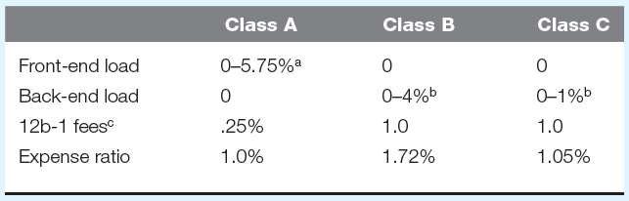
4.4 Costs of Investing in Mutual Funds
Avoiding the Load
  Choose different class of fund shares
Notes:
ª Depending on size of investment.
^{b} Depending on years until holdings are sold.
^{c} Including service fee of .25%.

Slide 16
4.4 Costs of Investing in Mutual Funds
Fees and Mutual Fund Returns
  Soft dollars: Value of research services brokerage house provides “free of charge” in exchange for business

Slide 17
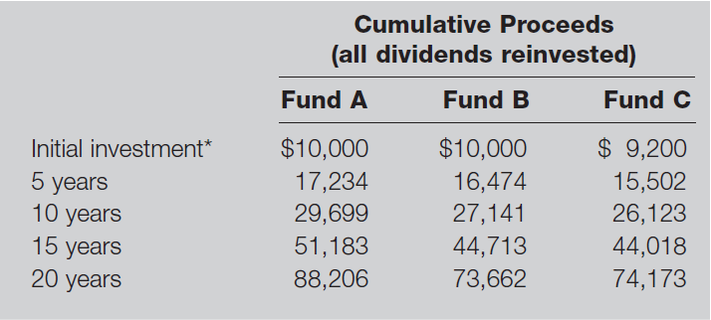
Table 4.2 Impact of Costs on Investment Performance
Notes: Fund A is no-load with .5% expense ratio, Fund B is no-load with 1.5% total expense ratio, and Fund C has an 8% load on purchases and a 1% expense ratio. Gross return on all funds is 12% per year before expenses.
* After front-end load, if any.

Slide 18
4.5 Taxation of Mutual Fund Income
General Tax Rules
  Fund not taxed if diversified and income distributed
  Investor taxed on capital gain and dividend distributions
  Turnover: Ratio of trading activity to assets of portfolio
  Portfolio turnover may affect investor’s tax liability

Slide 19
4.5 Taxation of Mutual Fund Income
Implications of Fund Turnover
  Fund pays commission costs on portfolio purchases and sales—charged against NAV
  Turnover rate measured as annual total asset value bought or sold in a year divided by average total asset value

Slide 20
4.6 Exchange-Traded Funds
Exchange-Traded Funds: Offshoots of mutual funds that allow investors to trade index portfolios
Potential Advantages
  Trade continuously throughout day
  Can be sold or purchased on margin
  Potentially lower tax rates
  Lower costs (no marketing, lower fund expenses)

Slide 21
4.6 Exchange-Traded Funds
Potential Disadvantages
  Small deviations from NAV possible
  Brokerage commission to buy ETF

Slide 22
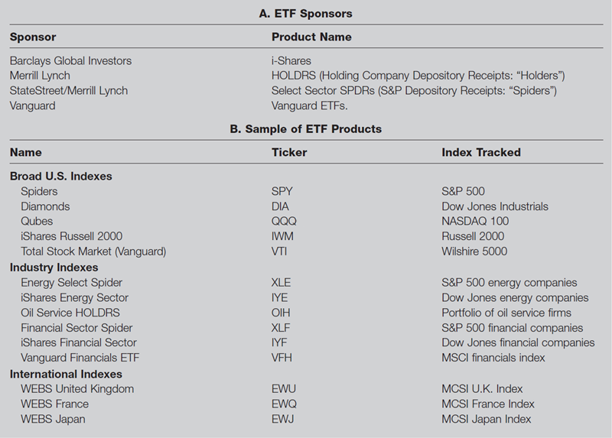
Table 4.3 ETF Sponsors and Products

Slide 23
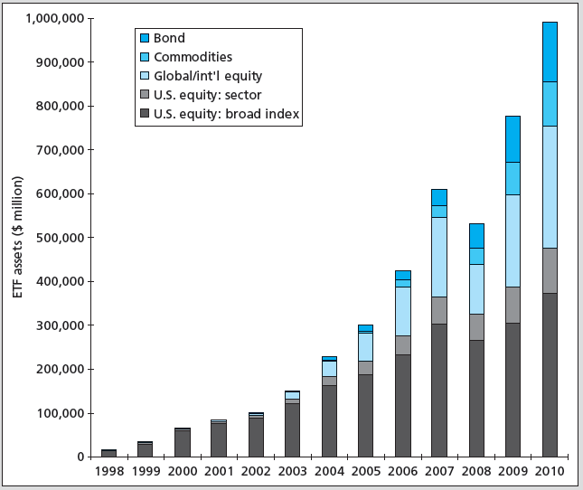
Figure 4.2 Assets in ETFs

Slide 24
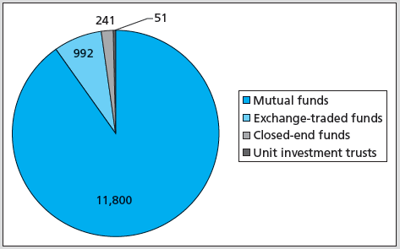
Figure 4.3 Investment Company Assets under Management, 2010 ($ Billion)

Slide 25
4.7 Mutual Fund Investment Performance
On average, mutual fund performance less than broad market performance
Evidence suggests some persistence in positive performance over certain horizons

Slide 26
Figure 4.4 Average Returns on Diversified Equity Funds vs. Wilshire 5000 Index

Slide 27
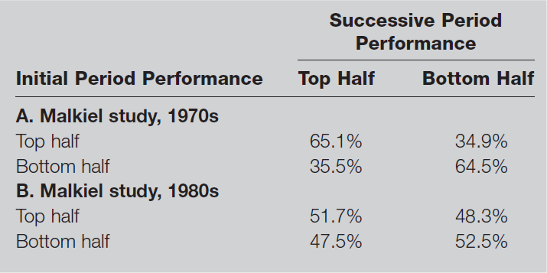
Table 4.4 Consistency of Investment Results

Slide 28
4.8 Information on Mutual Funds
Sources of Information on Mutual Funds
  Morningstar (www.morningstar.com)
  Fund prospectus
  Yahoo!
  The Wall Street Journal
  Investment Company Institute (www.ici.org)
  American Institute of Individual Investors
  Brokers

